Slide 1
Xapo Workplace Guide
2020

Slide 2
Introduction
Xapo is a culture of ownership. We are curious, resourceful, collaborative, and we hold each other accountable for driving results. We value team wins over individual contributions.
Xapo is a place for high performers with relentless focus, self-discipline, and passion to achieve something bigger than themselves. Xapo is not a place for everyone.
We chose you and you chose us. Welcome to Xapo.
We designed the Xapo Workplace Guide to ensure that you are set up for success from day one. It will help you understand Xapo and expectations for how we work. Reference it at any point during your time here.
Think of this guide as a living document, constantly evolving as we learn and share best practices in what we believe to be the future of work.

Slide 3


Working Remotely
Xapo is a fully distributed organization, offering unusual freedom and flexibility
At Xapo, we appreciate your unique skill set and the productivity that you bring to the organization, not the number of hours you’re sitting at your computer
Our home office and routine should help us be more productive, focused and organized
It should also help us be healthier and happier
Working remotely should not mean that we are less professional; rather, the right home office set-up enables us to be even more professional than people who work from an office

Slide 4

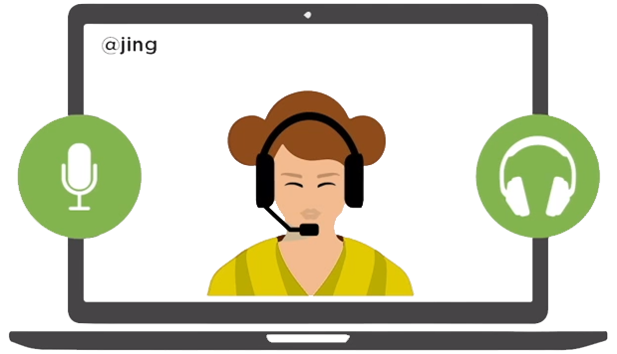
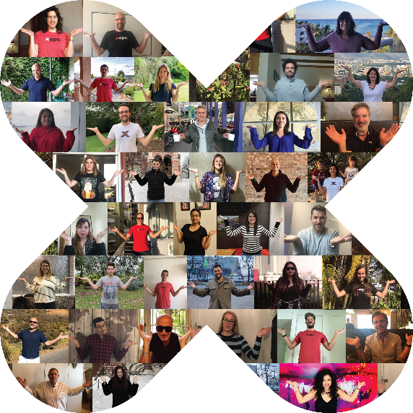
Content
Workplace Expectations
Challenges
Remote Work
Playbook
Diversity & Inclusion

Slide 5
Workplace Expectations
5
© 2020 Xapo. CONFIDENTIAL. All rights reserved

Slide 6

Xapien - Key Functional Competencies
ACTION
CHANGES
THINGS
Flexibility
Proactiveness
Teamwork/ Collaboration
Quickly adjust behavior to new information or changing circumstances. Be versatile and open-minded when interacting with others to achieve goals. Respond to change with a positive attitude and a willingness to learn new ways to accomplish work activities and objectives. Willing modify your preferred way of doing things.
Act in anticipation of future needs or opportunities by participating in new initiatives, generating constructive change, and performing in a proactive way to achieve personal and team goals. Take self-initiated and anticipatory actions to explore new avenues of impactful and positive change.
Work cooperatively with other associates and make valued contributions to the goals of others, even if it has no direct impact to you. Gain the trust and support of others by facilitating an open dialogue with a wide variety of contributors. Look for opportunities to work with other teams as a means to develop experience and knowledge. Look for informed opinions outside of your own to encourage diverse and open discussions.

Slide 7
We use English as a common language
Xapo has a global, remote workforce in over 50 countries. While many of our team members speak multiple languages, we communicate in English
High level of proficiency
In
English
Please.
verbal
written
Writing skills are particularly necessary because we communicate important information via Slack and email daily
and please make your best effort to work on your pronunciation

Slide 8
Communication Tools
How to stay connected in a distributed environment
Email
Slack
  Synchronous communication requiring an immediate response
  Team and company updates
  Social communications and “water-cooler chat”
  Asynchronous communication not
  requiring an immediate response
Over-communicate!
  Video meetings for face-to-face,
  real-time conversations
  BACK-UP
  International mobile
  (Internet fails, Slack down, etc.)
Zoom
WhatsApp

Slide 9

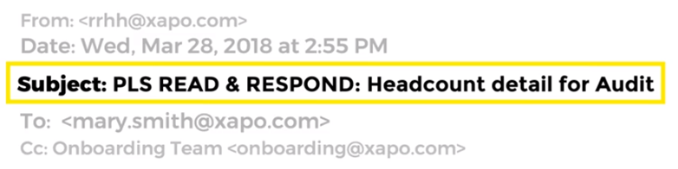

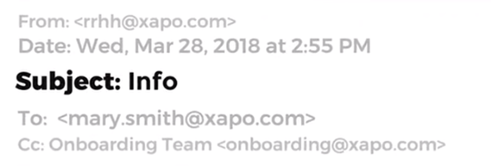

Email Expectations - Be clear
We respond to emails within 24 hours
1
If you want a response, state clearly:
      Whom you are expecting to respond
      What you need
      By when
    If you don’t do this, don’t expect a response
2
Have a set time every day to manage your inbox
Set your working hours in your calendar and keep it updated
If your calendar is showing as free and within your working hours, we will assume you are available for a meeting at that time
Notes:
En el slide 25 agregaria "if you don't state clearly to whom you are writing, what you are asking and by when, do not expect a reply"

Slide 10
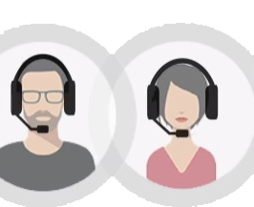

Slack Expectations - Be responsive
You must read all new messages in the #announcements Slack channel and your team’s Slack channel at least once a day
Has everyone downloaded the beta app for testing?
1
Yes! I followed the instructions that the Dev team posted in the Announcements channel this morning
If someone pings you using your @handle, you must acknowledge receipt within one hour, assuming you receive the message within your normal work schedule and you have NOT posted a status setting expectations for longer than normal response times
2
Has everyone downloaded the beta app for testing?
Set your work schedule and indicate whether you want to receive notifications outside of your work schedule
Configure the notifications for important groups to receive immediate notifications when there is activity in them. Request to receive these notifications via PC and phone to ensure you do not delay learning important information
We have a new app?! Since when?!
Please click to watch the complete Slack guidelines

Slide 11
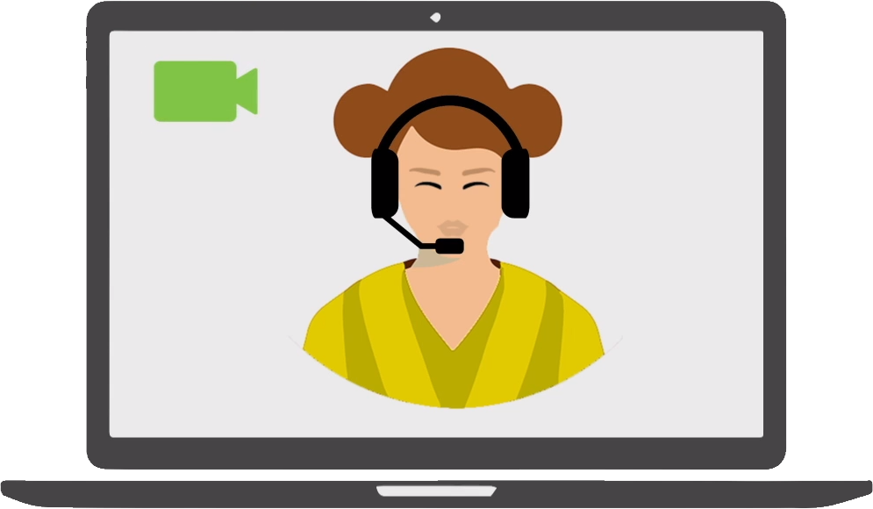

Videoconferencing Expectations - Be present
Always share your video
It is perceived as rude to not share the video when other parties are on video
1
Be present
Show that you are paying attention. Don’t multitask. Focus on the person on the other side of the screen
2
Use Gallery Mode in meetings with less than 10 attendees
This allows you to view everybody’s face, responses and reactions
Use Speaker View in meetings with more than 10 attendees
This allows to focus on the speaker without distraction
You are responsible for how you are heard and seen
Tip: ask someone to sit in your set-up and go somewhere else to call them and see how you can hear and see them
Please click to watch the complete Zoom guidelines

Slide 12
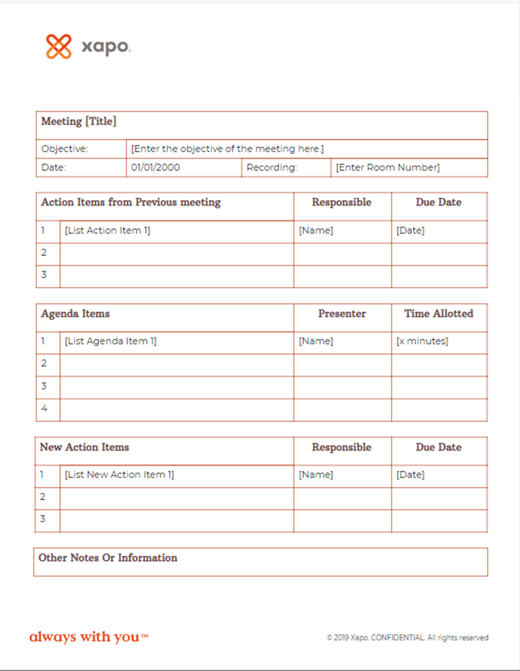
Meetings Expectations - Be effective
Decide the proper channel to achieve your goal
Is a meeting necessary or will an email suffice?
1
Set an agenda
Be respectful of your colleagues’ time by setting a clear agenda and goals when you schedule a meeting
Use only the time allotted – start and end
2
Send a recap
Send a follow-up email recapping what you discussed and any decisions that were made
Assign action items and deadlines
Click for linked template

Slide 13
Working Across Time Zones
Etiquette and best practices
Set the right expectations
Set your working hours in Slack and Google Calendar
Write a status if you’re sick, on holiday, or PTO
Create a shared team Google Calendar
Use it to your advantage
Use collaboration tools like Google Drive, team Slack channels, Jira, and Confluence to work on team projects around the clock
Make your work accessible to your team, add comments, and assign tasks to receive input from colleagues when they become available
Be flexible and reasonable
Meet at least once a week for a live Zoom meeting with your whole team, which could mean a time outside of your normal working hours
Be fair when selecting the time for this meeting, avoiding middle of the night hours
Be precise
When setting a deadline, be explicit about the day and time in GMT you are referring to
Get to know your colleagues
Learn your teammates’ schedules and be respectful of their time
Pay attention to cultural norms and regional holidays

Slide 14
Challenges
Remote work is the future, and we are aware that introduces new challenges. The following guidelines are to share our experience and help you navigate those challenges in a healthy and productive way.

Slide 15
Working Remotely Challenges
BURNOUT
LONELINESS
SECURITY
  Designate a place where you work and hours when you work. Make sure your manager knows your schedule. Set expectations with your team through Google calendar and Slack statuses. Disconnect at the end of the day.
  Over-communicate with your team. Always share your video in Zoom calls and expect the same from colleagues. Have regular team calls, actively participate in Slack channels, join Xapo Buddies, and schedule Donut Chats. Build networks inside and outside of Xapo (enjoy a hobby, spend time with family and friends, go to networking events).
  Follow security guidelines for your devices, connection, and communication. Use Amazon Workspaces, 2FA when possible, and be vigilant with information.

Slide 16
Remote work playbook

Slide 17
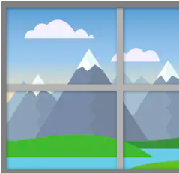
Steps to be successful working remotely
Key success factors learned over years of collective experience
Have a dedicated workspace
Establish a schedule and routine
1
2
If you can’t set up a dedicated workspace in your home, we recommend using a co-working space

Slide 18
Why is it important to have a dedicated workspace
1
Wellness & Productivity
Professional Environment
Separate work from the rest of your life
If you work in your living room, your kitchen, or your bedroom, you will associate all those places with working. Prevent burnout and sharpen your focus by separating spaces where you live and work.
Professional perception
Some people perceive working from home as less productive and less professional; at Xapo, we believe the opposite. Following the minimum home office guidelines, maintaining a neat appearance, and taking yourself and work seriously shows others that we enforce the highest standards of professionalism.
Develop and maintain healthy habits
Working from a dedicated space as if you are going to an office makes it easier to develop and maintain a healthy routine. Simple things like waking up at the same time every day, taking a shower, getting dressed, having healthy and nutritious meals, exercising, and reserving time for yourself, your loved ones, and your interests are all things that may help you be happier and healthier.
FOR YOU
Respect the person on the other side of the screen
The right home office set-up can help us focus and give our full attention to others, whether that’s in a team meeting, companywide Zoom call, or Slack conversation. Giving your undivided focus to someone shows that you respect them, their opinions, and their time. People can tell when you are multitasking or distracted, having the opposite effect on a relationship.
Productivity
A dedicated workspace helps you concentrate and be more productive. Make sure your space minimizes noise, distractions and temptations. Organize all the tools you need to do your job to be easily accessible, increasing efficiency.
Collaboration and Engagement
When people see that your background and appearance are neat and professional, and that you ensured all your tech is functioning properly, they may be more comfortable collaborating with you and feel that you are using their time well. If your video shows you working from a personal space (e.g. your bed is showing in the background), they may feel like they are imposing. Making the effort to appear professional and prepared puts people at ease and allows you to build strong relationships, without needing to meet often in person.
FOR OTHERS
Ergonomics
A healthy workspace prevents stress and injury. A good ergonomic set-up increases your efficiency and productivity, but ultimately keeps your comfort a top priority.

Slide 19
You must have a good Internet connection
1
It is imperative that you have a good internet connection.
The tools we use require you to be online. It is not possible to work with a bad connection. Instead, you will waste your time and productivity - and even worse, you will waste your team’s time and productivity
Can you hear me now?
You’re frozen

Slide 20
Setting up your dedicated workspace
1
Videoconferencing Requirements
Minimum
Standard
Maximum
Monitor and keyboard attached to laptop (ergonomic requirement - see next page)
Dedicated PC for videoconferencing app
Ultra High Definition Camera, with 90-degree wide angle lens
1
6
9
Professional level headphones with microphone
L-shaped desk
2
7
Tablet with stand to remotely control app and Camera
10
Professional background
Neutral background
8
3
Two screens, one on each side of the camera
11
Front Light
4
Logo / Name/ Job Title/ Location (recommended)
5

Slide 21
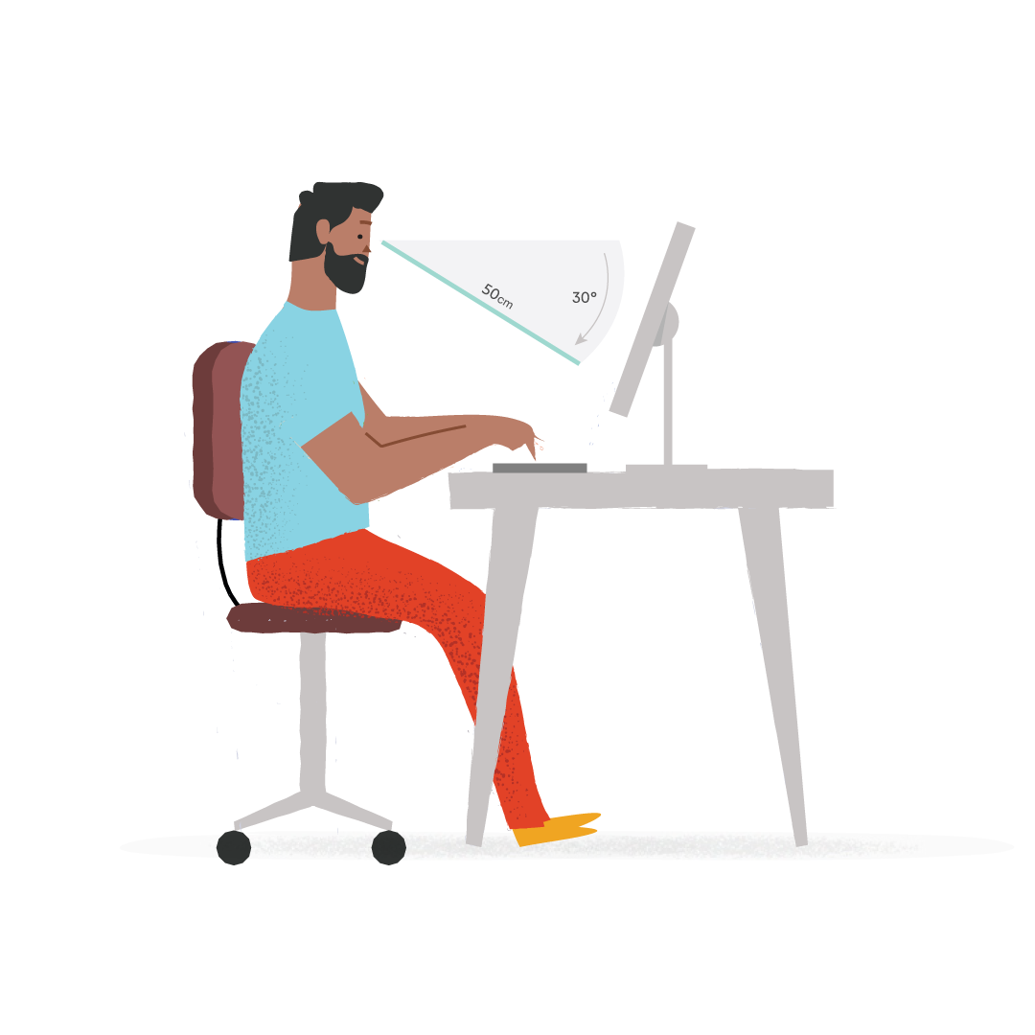
Setting up your dedicated workspace
1
Ergonomics - Consider what you really need to function properly
Furniture
Using proper furniture may seem pricey upfront, however there are many benefits to investing in quality pieces for your home office. Furniture that better meets your needs could benefit your productivity and health in the long run.
Recommendation: L-shaped furniture set-up is most effective for the type of meetings we have at Xapo (L-shaped desk, Swivel chair, Footrest, Drawers)
Laptop Use
When working at home, there is the increased likelihood that you will be using a laptop computer. The main challenge with using a laptop is that the screen is connected to the keyboard, so the screen and keyboard are not independently adjustable in height. If the laptop is at a good height for typing, chances are that it is too low for looking at the screen and vice versa. If it is at a good height for looking at the screen, it may be too high for typing.
The best solution for long term laptop use is to plug in an external keyboard and mouse and/or an external monitor, so these devices can be independently positioned at their own comfortable height.
Another risk associated with using a laptop at home is that there may be more opportunities for working in awkward postures, such as sitting on a couch or lying in bed. If you are using a laptop on your lap, your neck will be bent forward. Avoid this position as much as possible.
Note: Read this article for tips on furniture, laptop use, and addressing reduced activity level and physical discomfort.
Notes:
Why is it important to have a home office:
- For you:
- It helps you focus, concentrate and be more productive. Have a place without noise, distractions and temptations helps you focus. Having all the tools you need in one place helps you be more productive.
- It helps you separate work from the rest of your life. We places where we work with working. If you work in your living room, your kitchen and your bedroom you will associate all of those places with working and soon you will be working everywhere all the time in a way that come become unhealthy and can lead to being burned out or depressed.
- It helps you develop and maintain a healthy and productive habits. Working from home makes it hard to maintain a healthy routine. Simple things like getting out of bed, taking a shower, getting dressed, having a healthy and nutritious meal, exercising, having time for your loved you and for your interests, etc. are things that may be a lot harder to do when you work remotely and neglecting them may lead to being burned out or depressed. Having a separate place for work makes it a lot easier for you to develop - For others:
- It helps others perceive you as professional. Even though we know that we can be professional AND work from home, many people still think that if you are working from home you are not professional, and they will not take you seriously or even will prefer not working with you.
- It helps others feel like you respect them. The wrong home office setup can lead to us being distracted in a video call and not paying attention to the people who are in the call with us which makes them feel like we don't care about them or that we don't respect them. That may make them wish they did not work with us or that they worked with someone who was not remote.
- It helps others be more productive working remotely with you. When people feel like you are paying attention to them and you respect them, they are more engaged and productive, they enjoy working with you more and they do not need to meet you in person as much.
Home office guidelines:
1) Home office. Have a separate office at home where you can eliminate noise and where you can have a professional looking background. Que no se esuchen otros ruidos o personas de fondo. Que a la gente que participa de una videoconferencia con vos le de la impresion, por lo que ve y lo que escucha, que fue a tu oficina, NO a tu cocina, a tu living, a tu dormitorio u otro espacio personal.
2) Videconferencing PC. Have a separate PC for videoconferencing
3) Office layout. Have an L shaped desk with a desktop positioned in on side of the L and the videconferencing PC positionend in the other side of the L. Make sure that in the videoconferencing position the remote participants can see your hands and that the remote participants can see that you are paying full attention to them, that you do not have another keyboard or screen between them and you.
4) Videoconferencing screen & camera distance. Que la pantalla y la camara de la videoconferencing PC este por lo menos a 3 metros de distancia de tus ojos, e idealmente a 5 metros.
5) Videoconferencing screen & camera height. Place the videoconferencing screen should be as low as possible, much lower than screens are normally placed. The eyes of the local participant should be halfway between the videoconferencing camera at the top of the screen and the middle of the screen.
6) Headset. It is important to use a wired headset with a boom microphone, preferably with a microphone that filters your background noise. Do not use a wireless headset or a headset without a boom microphone. Only use a hands free speaker if more than one person are participating locally.
7) Lighting. Make sure you have good lighting coming from the direction of the camera so your face is seen clearly. Light coming from behind you will make it hard to see your face.
8) Open Broadcaster Software. Use this virtual webcam plugin to add Xapo's logo, your title and any disclaimer you need to add to your video stream.
9) Test: Once the setup is finished it is important to test it remotely FIRST. Focus on how remote participants will see you and hear you BEFORE you focus on how you will see and hear them. To do this ask someone to stand in for you in your home office while you go to a place where you cannot see them or hear them and you join their videoconference with them so you can check how people will see you and hear you and make any adjustments. When you test your home office setup as a remote participant make sure that:
- You can hear the person in your office clearly and without echo or noise
- You can see the face of the person in your office clearly
- You can see the hands of the person in your office and you cannot see any keyboards or screens in your field of vision so you know the person in your office if giving you their full attention.
- You feel like the person in your office is looking at you (approximately) when they talk to you.
- That the background looks professional, like an office (not personal)
10) Upgrade option 1: Use two videoconferencing screens. Use the biggest possible screens you can fit in your space, the bigger the screens the better. Two screens are useful because you can still see all the remote participants faces in one screen when the speaker or a shared document is shown in the other screen. When using two screens they should be centered in front of the local participant, as close together as possible (ideally touching each other) with the camera sitting between the two screens two thirds of the way up the screen.
11) Upgrade option 2: Use Zoom Rooms software in the videoconferencing PC instead of the personal Zoom client. The main advantage is that it allows you to control the videoconferencing PC with a dedicated iPad or Android device instead of a keyboard and mouse.
12) Hardware recommendations for all-in-one s:
- Recommended PCs:
- https://www.dell.com/en-us/shop/dell-desktop-computers/inspiron-22-3000-all-in-one-desktop/spd/inspiron-22-3275-aio
- https://www.lenovo.com/us/en/desktops-and-all-in-ones/ideacentre/c/Ideacentre
- https://www.apple.com/imac/
- Recommended headset: Sennheiser SC 660 https://en-us.sennheiser.com/professional-headset-call-center-office-sc-660-630
- Recommended system to use one keyboard and mouse and with them easily between the desktop PC and the videoconferencing PC https://www.logitech.com/en-us/product/unifying-receiver-usb (requires a compatible Logitech keyboard and mouse)
- Recommended camera for when the all-in-one PC does not have an embedded camera: https://www.logitech.com/en-us/product/c930e-webcam?crid=34
- Recommended speaker for when you have more than one local participant: https://www.jabra.com/business/speakerphones/jabra-speak-series/jabra-speak-410#/#7410-109 (used the wired version, not the wireless one)
13) Hardware recommendations for a 2-screen setup:- Recommended PC: https://www.intel.com/content/www/us/en/products/boards-kits/nuc/mini-pcs.html
- Recommended camera:
https://secure.logitech.com/en-us/product/rally-ultra-hd-ptz-camera
- Recommended headset: Sennheiser SC 660 https://en-us.sennheiser.com/professional-headset-call-center-office-sc-660-630
- Recommended speaker for when you have more than one local participant: https://www.jabra.com/business/speakerphones/jabra-speak-series/jabra-speak-410#/#7410-109 (used the wired version, not the wireless one)
- Recommended system to use one keyboard and mouse and swith them easily between the desktop PC and the videoconferencing PC https://www.logitech.com/en-us/product/unifying-receiver-usb (requires a compatible Logitech keyboard and mouse)
14) The videoconferencing screen and camera distance and height is important for two reasons:
1) For the remote participants feel like they are sitting at your desk. For them to have the same field of vision they would see if they came to meet with you in person. For example: the distance from your laptop camera to your face is too small, in person we do not talk to people so close to their face and being that close feels unconsciously uncomfortable, even if it is on video. Placing the videoconferencing camera at least 3 meters away (and ideally 5 meters away and then zooming in a bit) allows for the remote participants to have the same field of view they would have if they came to see you in person.
2) For remote participants to feel like you are looking at them. When you are participating in a videoconference you intuitively look at the remote participants in the screen but to the remote participants it does not look like you are looking at them because you are not looking at the camera. This can be fixed by placing the camera as close as possible to where you are going to be looking at and by placing it as far away from you as possible (at least 3 meters away and, ideally, 5 meters away). The further away the camera is the smaller the angle between where you are looking at and the camera and the more it feels like you are looking at the remote participants instead of looking away. That's why it is also important that the videconferencing screen be low enough so the eyes of the participants are more or less at the same height of your eyes, so it does not look like you are looking up (or down) and the camera should also be as aligned with your eyes as possible.
15) Noise reduction tips. If you have noise or echo in your home office you can use the following tips to reduce and even eliminate it:
- Rugs. Certaint types of rugs are powerful sound absorbers.
- Books: Books are powerful sound abosorbers, a shelf full of books can be more effective than sound absorbing panels.
- Sound absorbing panels (like this
https://www.amazon.com/pack-Acoustic-Panels-Soundproof-Insulation/dp/B07WDQSD6D/ref=sxin_3_ac_d_pm?ac_md=1-0-VW5kZXIgJDIw-ac_d_pm&crid=23Y2T97SF4IOB&keywords=sound+absorbing+panel&pd_rd_i=B07WDQSD6D&pd_rd_r=3f09463c-dd3c-4ab6-b904-1d68dc682c25&pd_rd_w=8sJb0&pd_rd_wg=hdmuL&pf_rd_p=24d053a8-30a1-4822-a2ff-4d1ab2b984fc&pf_rd_r=BS9DSNZNTW29JQP959W6&psc=1&qid=1571359388&sprefix=sound+absor%2Caps%2C261) can be placed in the roof, walls, under the desk and under the chairs. If you have a serious echo problem is important to put sound absorber panels facing in as many directions as possible.

Slide 22
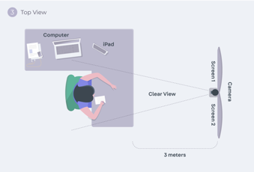
Home Office & Technology Recommendations
1
PC for videoconferencing
Have a separate PC for videoconferencing
L-shaped desk
One side for your desktop
Other side for videoconference
Tablet
The Zoom Room is controlled from a tablet, make sure that you can access it easily and that it is in a good stand because you will use it a lot to join and manage calls.
Show hands, no keyboards, no screens

Slide 23
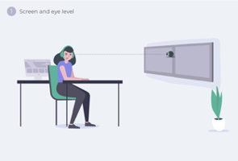
Home Office & Technology Recommendations
1
Camera
Ultra High Definition, with a 90 degree wide angle lens and controlled remotely. The camera should be directly in front of you, ideally not at an angle.
Camera height
Place the camera as low as possible. It should be positioned at a height that matches your eye level height. Eye level height is the most natural position and the most comfortable for the people talking to you on a video call, like in an in-person meeting.
Camera distance
The camera should be at least 2 meters from the edge of the desk that is closer to you, but ideally, 3 meters or more. If the camera is closer than 2 meters, it will appear to the people in the video call as though you are not looking at them when you talk (because the difference in angle between where you see them on the screen and the camera is too wide). The further back the camera is, the more it looks like you are looking at them when you talk and the more natural, comfortable, and similar to in-person meetings the video calls feel.

Slide 24
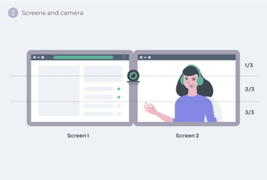
Home Office & Technology Recommendations
1
Screens
Place the screens as low as possible. We recommend the biggest screens you can fit in your space. The bigger the better
Screen setup
Two screens, one on each side of the camera. The screens should be as close to each other as possible, ideally touching each other, in which case you can mount the camera on a blade between the screens. With two screens, you can continue to see the person’s face when they are sharing a document - the shared document on one screen and their face and reactions on the other screen. When there are many people on a video call, you can see the person talking on one screen and everybody else’s reaction on the other screen
Screen height
The eyes of the people joining in a video call will generally be in the upper third of the screen -- that is intuitively where you will look at them. For others to feel as though you are looking at them when you are talking, your screen height should be adjusted so that the camera is ⅔ of the way up the screen.

Slide 25
Home Office & Technology Recommendations
1
Headset
Connect a wired headset with a boom mic and noise cancellation. It makes a big difference to have your voice come across clearly and without background noise, making the meeting feel more natural and comfortable like an in-person meeting.
Dual ear headset with mic boom and noise cancellation mic. Immerses you in the sound of the call and cancels background noise so that other participants can hear you clearly and without distractions, like in an in-person meeting.
Speakers
Speaker / Mic. You can connect a speaker/mic as a secondary audio source for when you have other people in your office that also need to participate in the call.
Clear sounds with an efficient mic and no echo. To use when you have more people at your office, and you cannot use your headphones.

Slide 26
Hardware Recommendations
1
Desktop | https://www.dell.com/en-us/shop/dell-desktop-computers/inspiron-22-3000-all-in-one-desktop/spd/inspiron-22-3275-aio https://www.lenovo.com/us/en/desktops-and-all-in-ones/ideacentre/c/Ideacentre https://www.apple.com/imac/
PC for Videoconferencing | https://www.intel.com/content/www/us/en/products/boards-kits/nuc/mini-pcs.html
Tablet | iPad Mini with Stand
Camera | https://secure.logitech.com/en-us/product/rally-ultra-hd-ptz-camera https://www.logitech.com/en-us/product/c930e-webcam?crid=34
Headset | Sennheiser SC 660 https://en-us.sennheiser.com/professional-headset-call-center-office-sc-660-630
Speakers | https://www.jabra.com/business/speakerphones/jabra-speak-series/jabra-speak-410#/#7410-109 (used the wired version, not the wireless one)
Mouse and Keyboard | https://www.logitech.com/en-us/product/unifying-receiver-usb
Recommended. Sennheiser DeskMate USB Headset.
Recommended. Jabra USB Speakerphone.

Slide 27
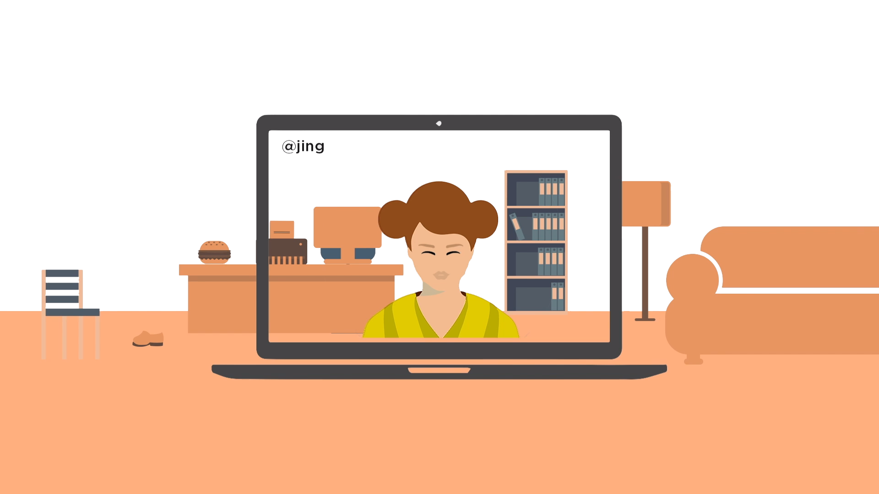
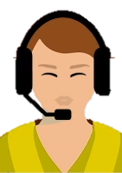
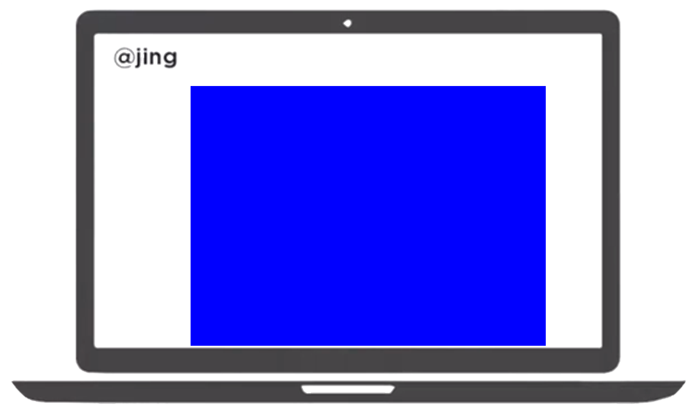
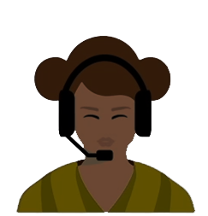
Once the set-up is finished: Test it FIRST
1
Focus on how remote participants will see you and hear you BEFORE you focus on how you will see and hear them. Test your home office set-up by having someone make a video call from it. Answer the call from another room to experience how you see and hear them. Make sure that:
You can hear the person in your office clearly and without echo or noise
You can see the face of the person in your office clearly
You can see the hands of the person in your office and you cannot see any keyboards or screens in your field of vision, so you know the person in your office if giving you their full attention
You feel like the person in your office is looking at you (approximately) when they talk to you
That the background looks professional, like an office (not personal)
Notes:
Why is it important to have a home office:
- For you:
- It helps you focus, concentrate and be more productive. Have a place without noise, distractions and temptations helps you focus. Having all the tools you need in one place helps you be more productive.
- It helps you separate work from the rest of your life. We places where we work with working. If you work in your living room, your kitchen and your bedroom you will associate all of those places with working and soon you will be working everywhere all the time in a way that come become unhealthy and can lead to being burned out or depressed.
- It helps you develop and maintain a healthy and productive habits. Working from home makes it hard to maintain a healthy routine. Simple things like getting out of bed, taking a shower, getting dressed, having a healthy and nutritious meal, exercising, having time for your loved you and for your interests, etc. are things that may be a lot harder to do when you work remotely and neglecting them may lead to being burned out or depressed. Having a separate place for work makes it a lot easier for you to develop - For others:
- It helps others perceive you as professional. Even though we know that we can be professional AND work from home, many people still think that if you are working from home you are not professional, and they will not take you seriously or even will prefer not working with you.
- It helps others feel like you respect them. The wrong home office setup can lead to us being distracted in a video call and not paying attention to the people who are in the call with us which makes them feel like we don't care about them or that we don't respect them. That may make them wish they did not work with us or that they worked with someone who was not remote.
- It helps others be more productive working remotely with you. When people feel like you are paying attention to them and you respect them, they are more engaged and productive, they enjoy working with you more and they do not need to meet you in person as much.
Home office guidelines:
1) Home office. Have a separate office at home where you can eliminate noise and where you can have a professional looking background. Que no se esuchen otros ruidos o personas de fondo. Que a la gente que participa de una videoconferencia con vos le de la impresion, por lo que ve y lo que escucha, que fue a tu oficina, NO a tu cocina, a tu living, a tu dormitorio u otro espacio personal.
2) Videconferencing PC. Have a separate PC for videoconferencing
3) Office layout. Have an L shaped desk with a desktop positioned in on side of the L and the videconferencing PC positionend in the other side of the L. Make sure that in the videoconferencing position the remote participants can see your hands and that the remote participants can see that you are paying full attention to them, that you do not have another keyboard or screen between them and you.
4) Videoconferencing screen & camera distance. Que la pantalla y la camara de la videoconferencing PC este por lo menos a 3 metros de distancia de tus ojos, e idealmente a 5 metros.
5) Videoconferencing screen & camera height. Place the videoconferencing screen should be as low as possible, much lower than screens are normally placed. The eyes of the local participant should be halfway between the videoconferencing camera at the top of the screen and the middle of the screen.
6) Headset. It is important to use a wired headset with a boom microphone, preferably with a microphone that filters your background noise. Do not use a wireless headset or a headset without a boom microphone. Only use a hands free speaker if more than one person are participating locally.
7) Lighting. Make sure you have good lighting coming from the direction of the camera so your face is seen clearly. Light coming from behind you will make it hard to see your face.
8) Open Broadcaster Software. Use this virtual webcam plugin to add Xapo's logo, your title and any disclaimer you need to add to your video stream.
9) Test: Once the setup is finished it is important to test it remotely FIRST. Focus on how remote participants will see you and hear you BEFORE you focus on how you will see and hear them. To do this ask someone to stand in for you in your home office while you go to a place where you cannot see them or hear them and you join their videoconference with them so you can check how people will see you and hear you and make any adjustments. When you test your home office setup as a remote participant make sure that:
- You can hear the person in your office clearly and without echo or noise
- You can see the face of the person in your office clearly
- You can see the hands of the person in your office and you cannot see any keyboards or screens in your field of vision so you know the person in your office if giving you their full attention.
- You feel like the person in your office is looking at you (approximately) when they talk to you.
- That the background looks professional, like an office (not personal)
10) Upgrade option 1: Use two videoconferencing screens. Use the biggest possible screens you can fit in your space, the bigger the screens the better. Two screens are useful because you can still see all the remote participants faces in one screen when the speaker or a shared document is shown in the other screen. When using two screens they should be centered in front of the local participant, as close together as possible (ideally touching each other) with the camera sitting between the two screens two thirds of the way up the screen.
11) Upgrade option 2: Use Zoom Rooms software in the videoconferencing PC instead of the personal Zoom client. The main advantage is that it allows you to control the videoconferencing PC with a dedicated iPad or Android device instead of a keyboard and mouse.
12) Hardware recommendations for all-in-one s:
- Recommended PCs:
- https://www.dell.com/en-us/shop/dell-desktop-computers/inspiron-22-3000-all-in-one-desktop/spd/inspiron-22-3275-aio
- https://www.lenovo.com/us/en/desktops-and-all-in-ones/ideacentre/c/Ideacentre
- https://www.apple.com/imac/
- Recommended headset: Sennheiser SC 660 https://en-us.sennheiser.com/professional-headset-call-center-office-sc-660-630
- Recommended system to use one keyboard and mouse and with them easily between the desktop PC and the videoconferencing PC https://www.logitech.com/en-us/product/unifying-receiver-usb (requires a compatible Logitech keyboard and mouse)
- Recommended camera for when the all-in-one PC does not have an embedded camera: https://www.logitech.com/en-us/product/c930e-webcam?crid=34
- Recommended speaker for when you have more than one local participant: https://www.jabra.com/business/speakerphones/jabra-speak-series/jabra-speak-410#/#7410-109 (used the wired version, not the wireless one)
13) Hardware recommendations for a 2-screen setup:- Recommended PC: https://www.intel.com/content/www/us/en/products/boards-kits/nuc/mini-pcs.html
- Recommended camera:
https://secure.logitech.com/en-us/product/rally-ultra-hd-ptz-camera
- Recommended headset: Sennheiser SC 660 https://en-us.sennheiser.com/professional-headset-call-center-office-sc-660-630
- Recommended speaker for when you have more than one local participant: https://www.jabra.com/business/speakerphones/jabra-speak-series/jabra-speak-410#/#7410-109 (used the wired version, not the wireless one)
- Recommended system to use one keyboard and mouse and swith them easily between the desktop PC and the videoconferencing PC https://www.logitech.com/en-us/product/unifying-receiver-usb (requires a compatible Logitech keyboard and mouse)
14) The videoconferencing screen and camera distance and height is important for two reasons:
1) For the remote participants feel like they are sitting at your desk. For them to have the same field of vision they would see if they came to meet with you in person. For example: the distance from your laptop camera to your face is too small, in person we do not talk to people so close to their face and being that close feels unconsciously uncomfortable, even if it is on video. Placing the videoconferencing camera at least 3 meters away (and ideally 5 meters away and then zooming in a bit) allows for the remote participants to have the same field of view they would have if they came to see you in person.
2) For remote participants to feel like you are looking at them. When you are participating in a videoconference you intuitively look at the remote participants in the screen but to the remote participants it does not look like you are looking at them because you are not looking at the camera. This can be fixed by placing the camera as close as possible to where you are going to be looking at and by placing it as far away from you as possible (at least 3 meters away and, ideally, 5 meters away). The further away the camera is the smaller the angle between where you are looking at and the camera and the more it feels like you are looking at the remote participants instead of looking away. That's why it is also important that the videconferencing screen be low enough so the eyes of the participants are more or less at the same height of your eyes, so it does not look like you are looking up (or down) and the camera should also be as aligned with your eyes as possible.
15) Noise reduction tips. If you have noise or echo in your home office you can use the following tips to reduce and even eliminate it:
- Rugs. Certaint types of rugs are powerful sound absorbers.
- Books: Books are powerful sound abosorbers, a shelf full of books can be more effective than sound absorbing panels.
- Sound absorbing panels (like this
https://www.amazon.com/pack-Acoustic-Panels-Soundproof-Insulation/dp/B07WDQSD6D/ref=sxin_3_ac_d_pm?ac_md=1-0-VW5kZXIgJDIw-ac_d_pm&crid=23Y2T97SF4IOB&keywords=sound+absorbing+panel&pd_rd_i=B07WDQSD6D&pd_rd_r=3f09463c-dd3c-4ab6-b904-1d68dc682c25&pd_rd_w=8sJb0&pd_rd_wg=hdmuL&pf_rd_p=24d053a8-30a1-4822-a2ff-4d1ab2b984fc&pf_rd_r=BS9DSNZNTW29JQP959W6&psc=1&qid=1571359388&sprefix=sound+absor%2Caps%2C261) can be placed in the roof, walls, under the desk and under the chairs. If you have a serious echo problem is important to put sound absorber panels facing in as many directions as possible.

Slide 28
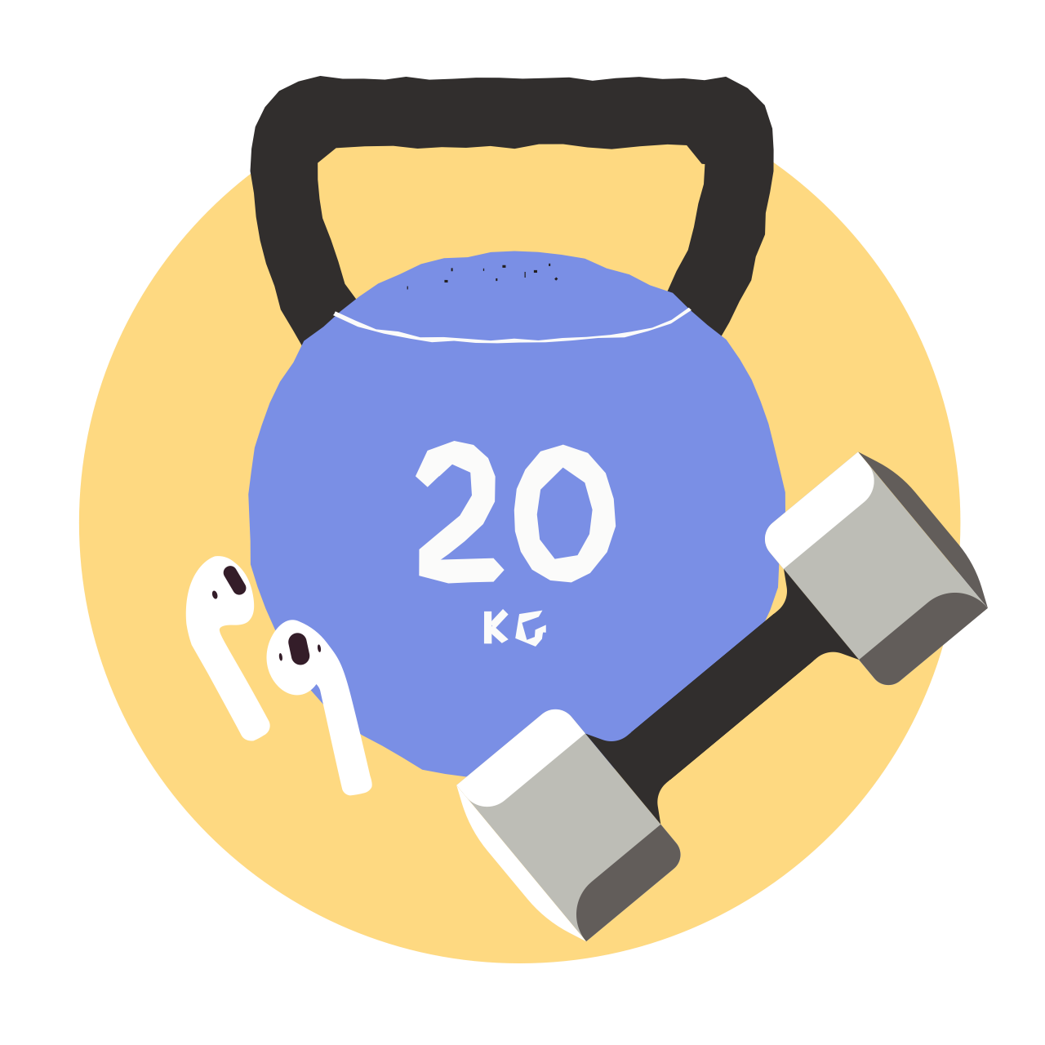

Follow a schedule and routine
2
Plan every day
WELLNESS
TIME MANAGEMENT
  Follow a schedule and routine. Take screen breaks and eat your lunch away from your desk. Get some form of physical exercise every day. Get as much sleep as your body requires (set sleeping hours).
  Plan every day. Know what you need to accomplish and what hours of the day are better for you for creative versus administrative tasks. Block your schedule accordingly and hold yourself accountable. Minimize distractions.

Slide 29

Life is short, enjoy it!
2
Once you’ve unplugged for the day, get out and do things you enjoy!
Making time for your interests outside of work makes the hours you are working more focused and productive
Invest in yourself!
Find what fulfills you. Engage with your community. Meet with family and friends in person. Immerse yourself in a hobby. Explore your curiosities
Challenge yourself physically, creatively, intellectually - you decide! You’ll be a healthier, happier person if you make an effort to move more, interact more, and learn more
Pay it forward!
Fuel your purpose!

Slide 30

Enjoy meals away from your desk
2
Studies show that eating at your
desk may lead to:
1. Increased long-term health risks
2. Sore joints
3. Stress
4. Brain fog
5. Reduced productivity
6. Lack of balance
7. Missing out on inspiration

Slide 31
Pros
While remote work has its challenges, the pros far outweigh the cons for the right people. If it works for you, there’s no going back!

Slide 32
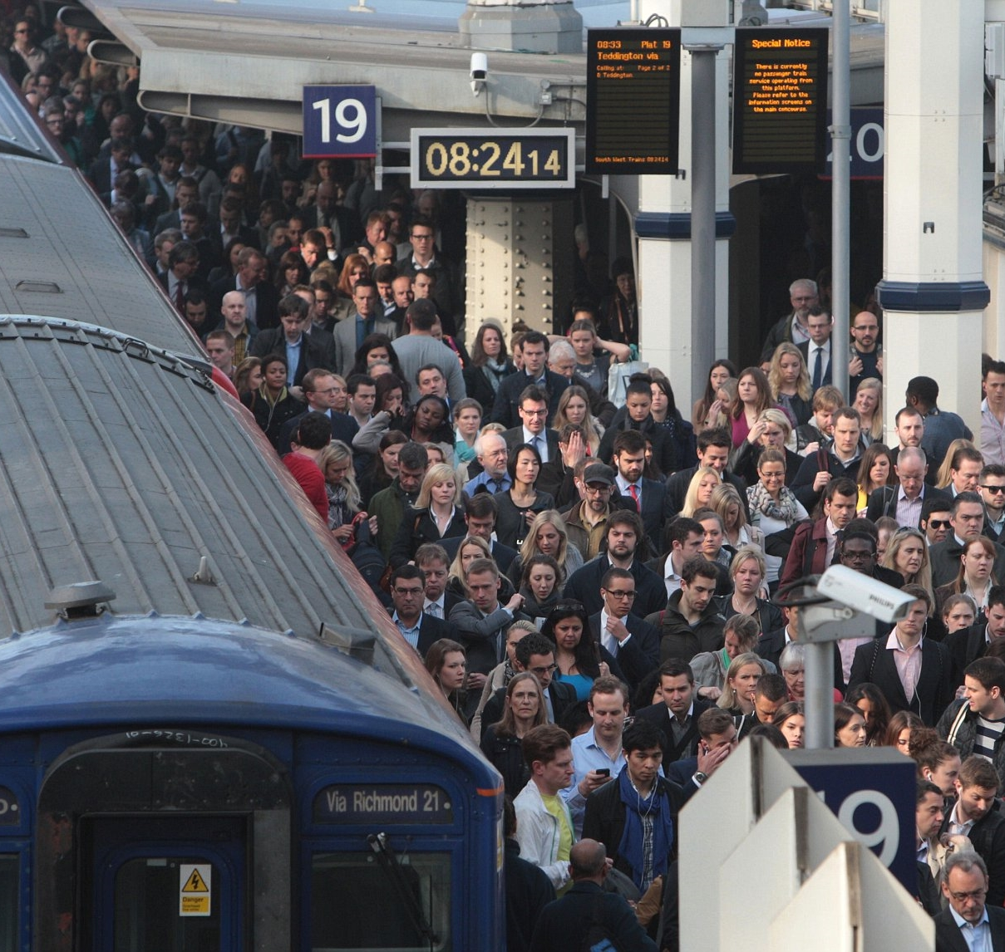
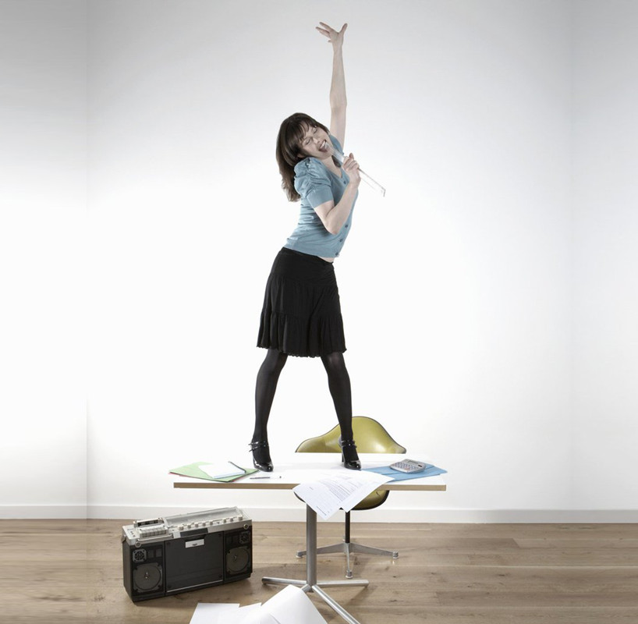
Embrace the Pros
Go green! Working from home means no commute
© 2020 Xapo. CONFIDENTIAL. All rights reserved

Slide 33

Embrace the Pros
Go green! Working from home means no commute
Have kids? Be there for drop off, pick up, and the unexpected
© 2020 Xapo. CONFIDENTIAL. All rights reserved

Slide 34
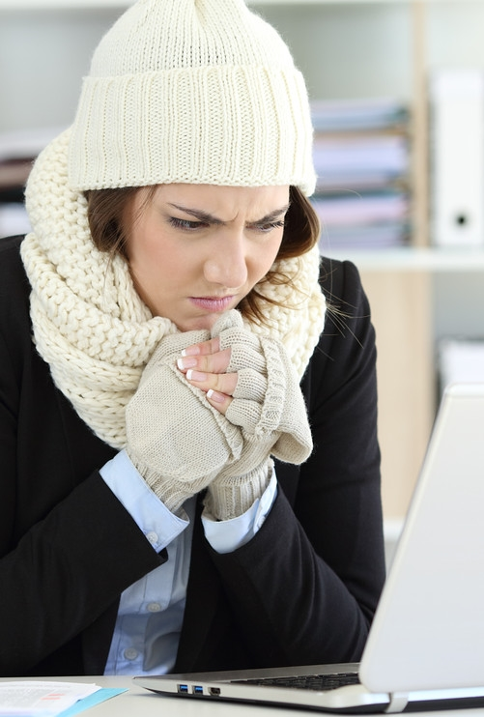
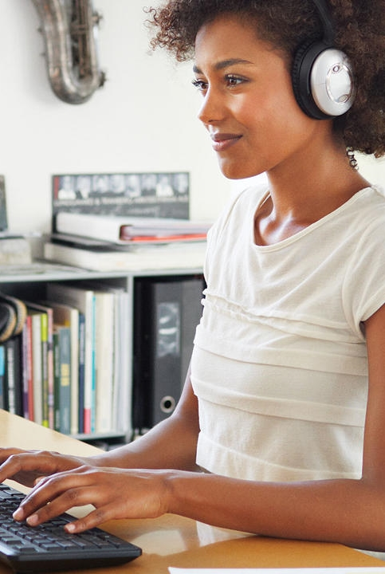
Embrace the Pros
Go green! Working from home means no commute
Have kids? Be there for drop off, pick up, and the unexpected
No more freezing or burning up at a cubicle! Set the thermostat to whatever temperature you like
© 2020 Xapo. CONFIDENTIAL. All rights reserved

Slide 35
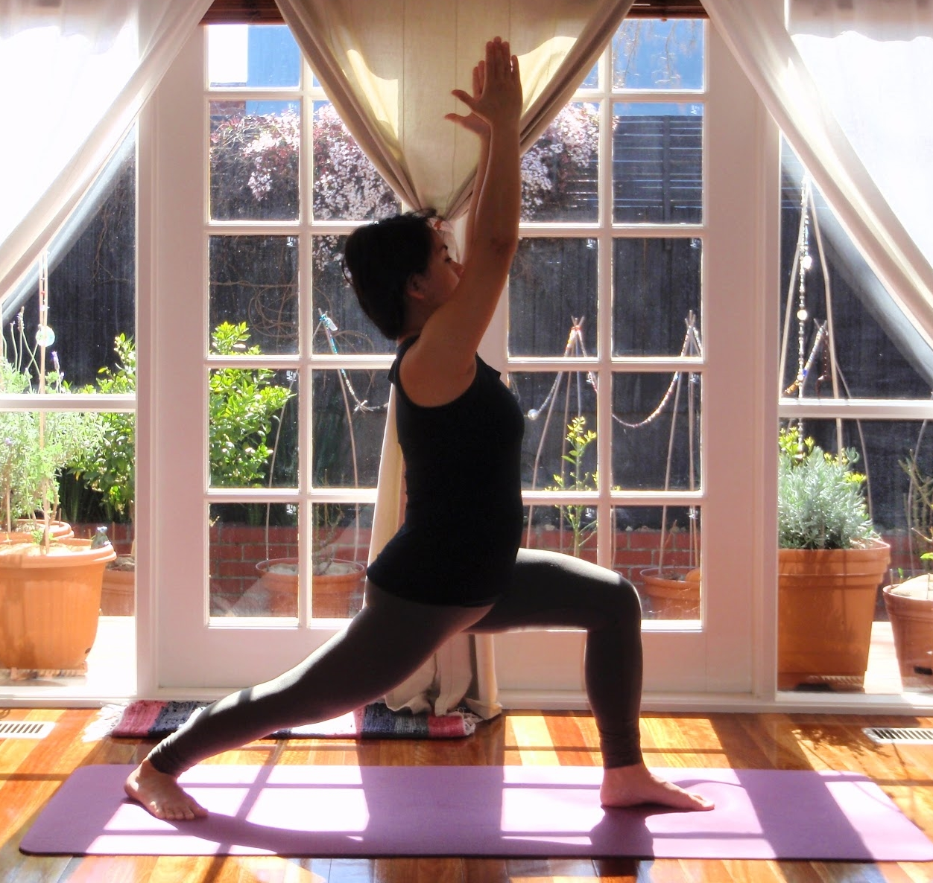
Embrace the Pros
Go green! Working from home means no commute
Have kids? Be there for drop off, pick up, and the unexpected
No more freezing or burning up at a cubicle! Set the thermostat to whatever temperature you like
Clear your head with a midday run, yoga, or game of fetch
© 2020 Xapo. CONFIDENTIAL. All rights reserved

Slide 36
Embrace the Pros
Go green! Working from home means no commute
Have kids? Be there for drop off, pick up, and the unexpected
No more freezing or burning up at a cubicle! Set the thermostat to whatever temperature you like
Clear your head with a midday run, yoga, or game of fetch
Desk karaoke! Blast your favorite playlist and sing along at full volume
© 2020 Xapo. CONFIDENTIAL. All rights reserved

Slide 37

Go green! Working from home means no commute
Have kids? Be there for drop off, pick up, and the unexpected
No more freezing or burning up at a cubicle! Set the thermostat to whatever temperature you like
Clear your head with a midday run, yoga, or game of fetch
Desk karaoke! Blast your favorite playlist and sing along at full volume
Take work with you. Once you master the challenges of working remotely, save PTO by staying productive during your trips and visits. Set up your office at your family’s house across the ocean, or wherever else you choose!
© 2020 Xapo. CONFIDENTIAL. All rights reserved

Slide 38
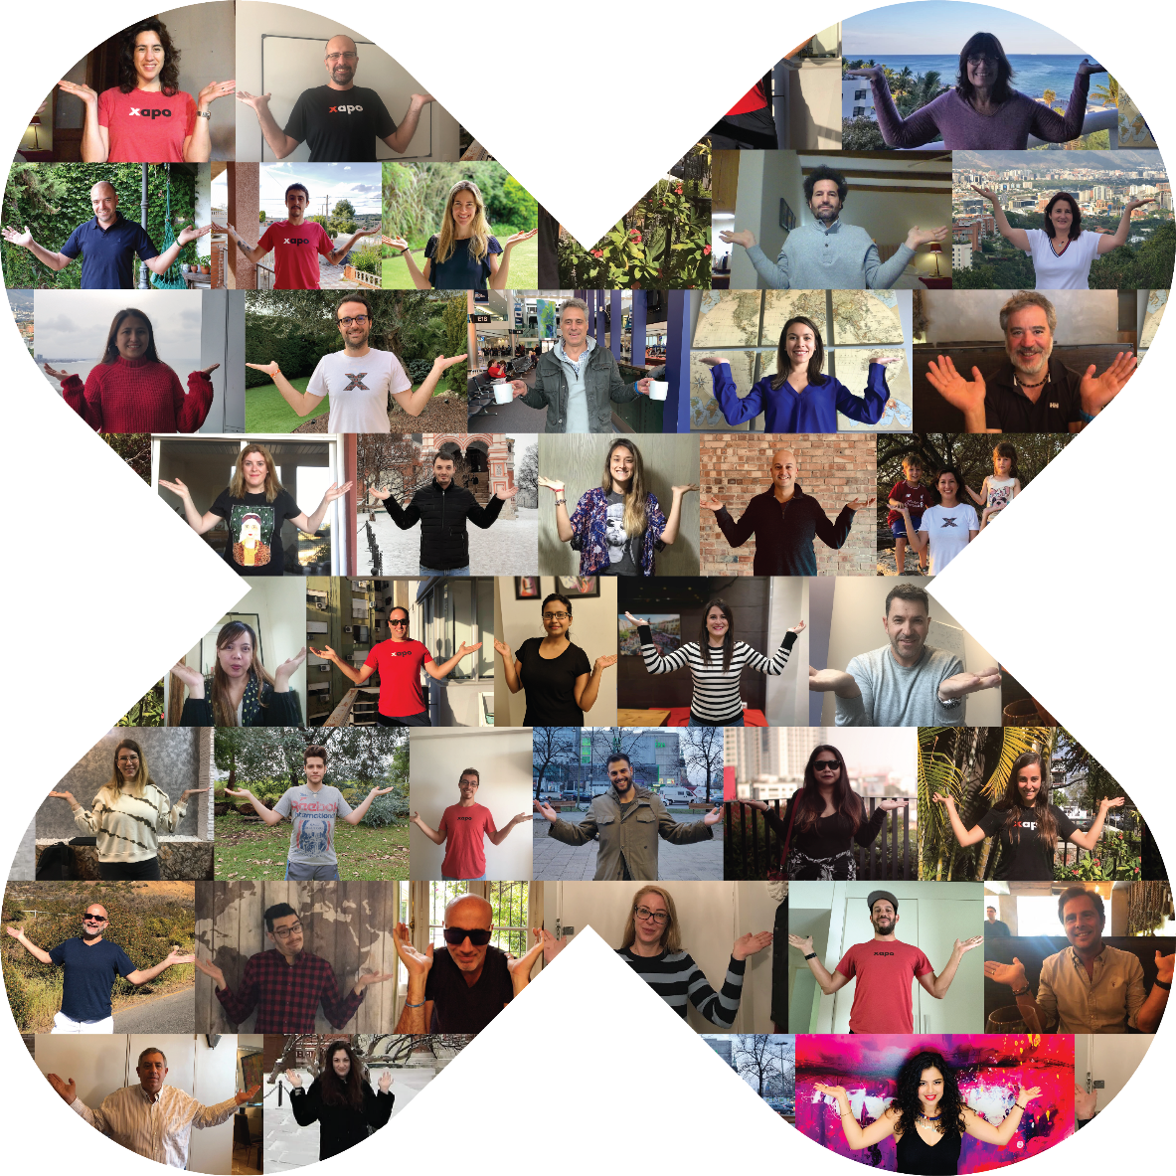
Diversity and Inclusion
38
© 2020 Xapo. CONFIDENTIAL. All rights reserved

Slide 39


















































Diversity
Representing a variety of backgrounds, cultures, and experiences is critical to our success as a global company
50+
… with one
single mission
countries
We are committed to cultivating a culture of respect and equal opportunity
Each individual, regardless of any aspect of their identity…
gender
age
nationality
sexual orientation
ethnicity
religion
disability status
other
… should feel welcome, valued, and included at Xapo

Slide 40



Inclusion
Each of us is responsible for fostering an inclusive environment, where all Xapiens are comfortable bringing their whole selves to work every day
DIVERSITY
INCLUSION
In meetings and other team collaboration, we must ensure that all voices are heard and considered
We encourage new ideas regardless of what level, department or location in the organization they come from
Developing a diverse and inclusive environment is an ongoing effort at Xapo:
Training
Work to overcome our unconscious biases
Question our assumptions
Openly communicate and ask questions to broaden our understanding

Slide 41
Workplace Guide
2020

