Slide 1
EdTech Demand Generation
Jimmy Montchal

Slide 2

Agenda
What is demand generation?
How is it implemented?
Planning & Execution
Goals & Measurement
Questions

Slide 3

What is Demand Generation?
Demand generation describes the marketing process used to drive awareness and interest in a company’s products and/or services.
Programs
Campaigns
Segmentation
Personalization
Lead scoring
Predictive scoring
Sales & Marketing Alignment
Nurturing

Slide 4

What Demand Generation Accomplishes
Demand generations goals are to execute programs that engage prospects to create a hand raise, whether that be from:
An event, webinar, or other program
Website, content piece, or blog
SDR team
We then pass this lead and the information we have gathered to the sales team to aid in pipeline acceleration.

Slide 5
Demand Generation In Action
Goal: MQL
Goal: SQL
Goal: SAL
Goal: Bookings
Ebooks
What is XX
How To: Workflow
Competitor Evaluation
Anonymous
Known
Demo Set
Opp Open
Blog Posts
Case Study
Webinar
ROI Calculator
Nurture
eBook
Case Study
Infographic
Webinar
Calculator

Slide 6
How is it implemented?

Slide 7

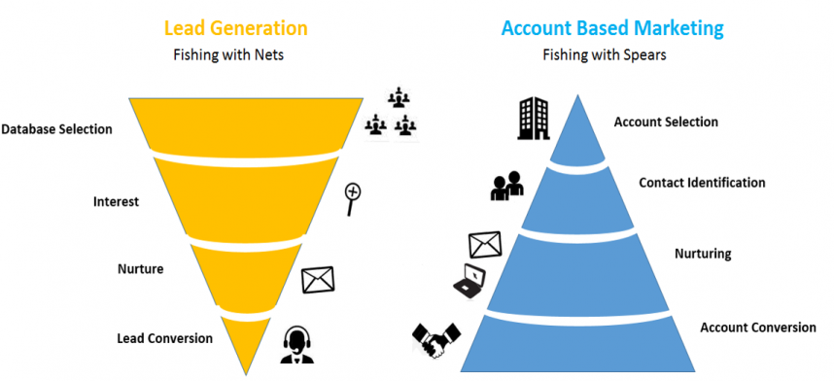
Demand Gen Programming
There are two main strategies that are deployed.

Slide 8

Tiered Accounts
Demand generation efforts should be focused on tiers of accounts.
Tier | 1 | 2 | 3
Working? | AE | BDR | Marketing
Qualification? | Systems, Strategic Accounts | > XXX FTE | < XXX FTE
Program? | ABM | ABM & Lead Generation | Lead Generation

Slide 9
Lead Generation
Targets
Tier 2 & 3 Accounts (1000s)
Channels
National Email
Website Overlays
Paid Media (Retargeting)
SDR Website Notifications
Webinars
Events
LinkedIn Display Ads (Opportunity Funnel)

Slide 10
60% of companies that use ABM saw a revenue increase of at least 10% within 12 months, while 1 in 5 companies experienced a revenue increase of 30% or more.
SiriusDecisions - The Pace of Account-Based Marketing Accelerates
Notes:
60% of companies that use ABM saw a revenue increase of at least 10% within 12 months, while 1 in 5 companies experienced a revenue increase of 30% or more.
How, you ask?
The answer lies in average deal size.
In a study by SiriusDecisions, 91% of companies using ABM were able to increase their average deal size, with 25% of respondents stating the increase being over 50% or larger!
This is further backed up ABM Leadership Alliance, who found through their own research that B2B marketers saw an increase in average annual contract value of 171% after implementing their ABM strategy.

Slide 11
Account-based Marketing
Targets
Tier 1 Target Accounts (100s)
Channels
Email (Personalized)
ABM Website Overlays (Funnel based)
Paid Media (Prospecting)
RSM Website Notifications
ABM Display Ads (Opportunity Funnel)
Events (Dinner Invite, Bag Drop)
Webinars (Regional)
Direct Mail (high value)

Slide 12
Planning & Executing

Slide 13

Program & Content Planning
How do we create a strategy where there is ownership felt by everyone?
Quarterly Program Plan
Targets: Based on booking goals
Look at existing pipeline health, work backwards based on product goals
Messaging/Positioning
Themes surface
Categorized by Tier of Account
Channels
Which channels do with use with the content
What content holes do we have that need to be filled
Timelines
Delivery Week
Example Content Holes based on Program needs
Case Study and Press Releases
Content (blogs, infographics, ebooks, video)
Product Releases

Slide 14
Tier 1 - Stage 1: Accounts - Unaware
Stage 1:
Accounts
Unaware
Stage 2:
Aware No Meeting
Stage 3:
Meeting No Opp
Stage 4:
Pipeline
Open
Stage 5:
Pipeline
Closed
Paid Media - Pointing to blog/resource
Aware
MA - Top Account Unaware Email (Persona based)
Sales - LinkedIn Touches
The goal is to get them to engage with your company. Outside events, the main focus is on meeting them where they are (digitally) and showing thought-leadership type content.
What do we need to make this happen?
Paid Media - 3 sets of ads focused on 3 sets of content (pair content as much as possible)
Marketing Automation - 6 email series (bi-weekly)
Social Touches - BDR or the AE visiting high value contacts LinkedIn profiles

Slide 15
Tier 1 - Stage 2: Aware- No Meeting
Stage 1:
Accounts
Unaware
Stage 2:
Aware No Meeting
Stage 3:
Meeting No Opp
Stage 4:
Pipeline
Open
Stage 5:
Pipeline
Closed
Paid Media - Pointing to buyers guide and infographics
Meeting
Sales - AE Top Account Sequence (Persona based)
Website - Content Path
Direct Mail
The goal is to get them to set a meeting with us. We will use consideration level content and persona based pain points in messaging. On the website, we will have specific content paths for the account category they will be recommended towards.
What do we need to make this happen?
Paid Media - 3 sets of ads focused on 3 sets of content (pair content as much as possible)
Outreach - 12 week series (Email, Phone, Social Touches)
Website - Targeted overlays with all campaign pieces
Direct Mail - High value package

Slide 16
Tier 1 - Stage 3: Meeting - No Opp
Stage 1:
Accounts
Unaware
Stage 2:
Aware No Meeting
Stage 3:
Meeting No Opp
Stage 4:
Pipeline
Open
Stage 5:
Pipeline
Closed
Paid Media - Pointing to one sheeters and case studies
Pipeline: Open
Sales - AE communication
Website - Content Path
In-Person - AE Visit
The goal is to get them to open an opportunity. Communication is managed by the RSM with support from Marketing with Paid Media (mid-funnel), Website Personalization and Account level tracking.
What do we need to make this happen?
Paid Media - 3 sets of ads focused on 3 sets of content (pair content as much as possible)
Outreach - Sales managed touches (alerts for no sales touches after 30 days)
Website - Targeted overlays with all campaign pieces
In-Person - If we haven’t opened an opp yet, we could offer an on-site visit from RSM, SE, &/or Exec

Slide 17
Tier 1 - Stage 4: Pipeline Open
Stage 1:
Accounts
Unaware
Stage 2:
Aware No Meeting
Stage 3:
Meeting No Opp
Stage 4:
Pipeline
Open
Stage 5:
Pipeline
Closed
Paid Media - Pointing to case studies and solution briefs
Pipeline: Closed
Sales - AE communication
Website - Content Path
The goal here is to accelerate the Opportunity to Closed Won. Communication is managed by the RSM with support from Marketing with Paid Media (late-funnel), Website Personalization and Account level tracking.
What do we need to make this happen?
Paid Media - 3 sets of ads focused on 3 sets of content (pair content as much as possible)
Outreach - Sales managed touches (alerts for no sales touches after 30 days)
Website - Targeted overlays with all campaign pieces

Slide 18
Goals & Measuring

Slide 19

Goals
Our main goals with Demand Generation are to:
Source XX% of closed won bookings
Identify interested accounts through anonymous and known interaction
Provide a personalized buying experience for our prospects
Building awareness during the Opportunity process with stakeholders
Cross-sell and upsell nurturing and targeting
Accelerate the journey of a prospect from anonymous to closed won bookings

Slide 20
Measuring by Stage
Early
Focus is mostly on cost per lead.
Mid
Focus is on connecting & meeting setting.
Late
Focused on revenue & meeting conversion rate.
Cost Per Program
Cost Per Target
Cost Per Name
New Account Names
New Account Targets
# of Accounts Engaged
Call Connects
# of Meetings
Marketing Qualified Leads
# of Account Targets Engaged
# of Opportunities
Opportunity Creation
Cost/Opp Creation
Closed Won Ratio
Closed Won Bookings
Average Opp Age

Slide 21
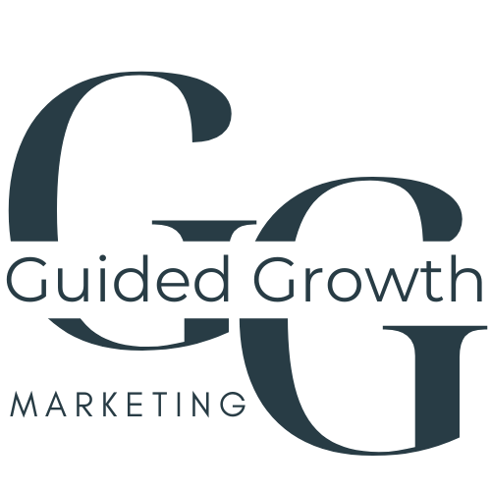
Thank You!

